Slide 1




Slide 2
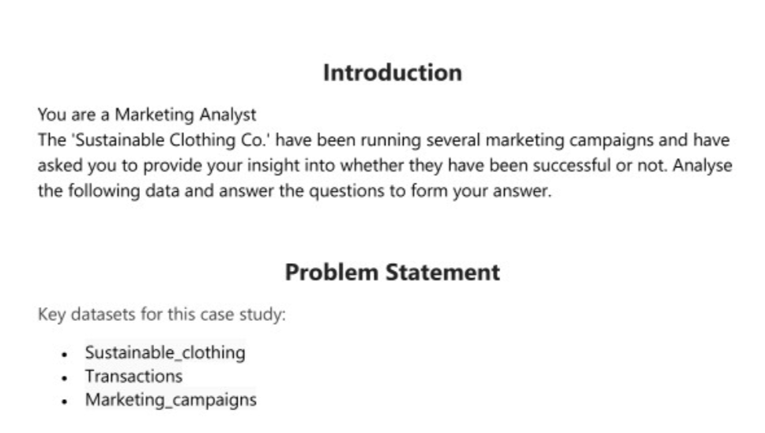

Slide 3
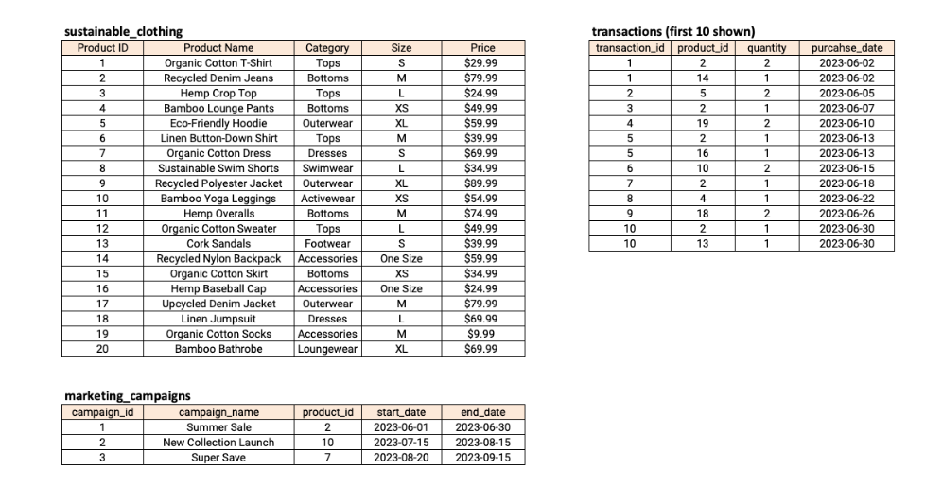

Slide 4
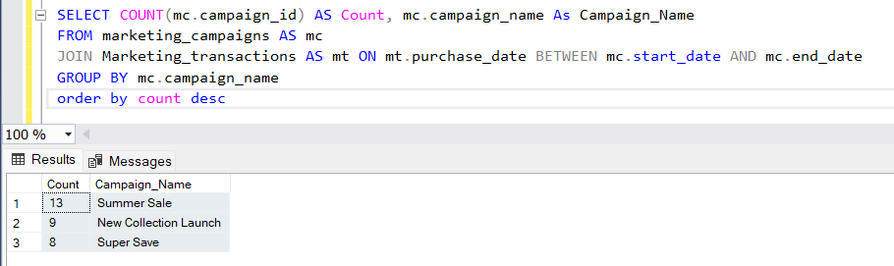
1. How many transactions were completed during each marketing campaign?

Slide 5
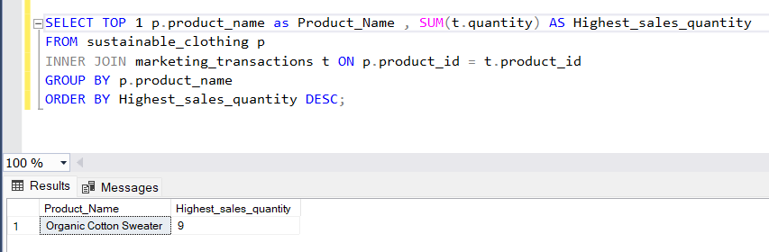
2. Which product had the highest sales quantity?

Slide 6
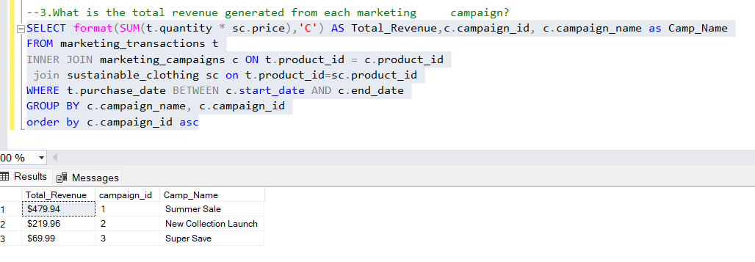
3. What is the total revenue generated from each marketing campaign?

Slide 7
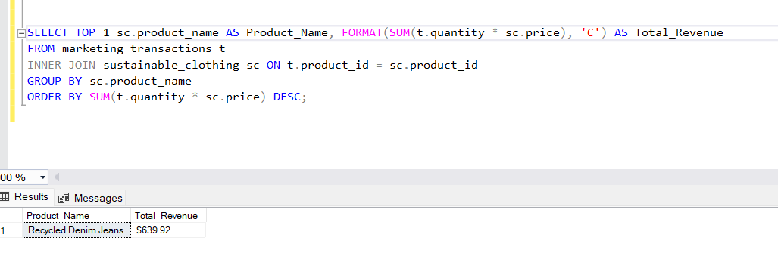
4. What is the top-selling product category based on the total revenue generated?

Slide 8
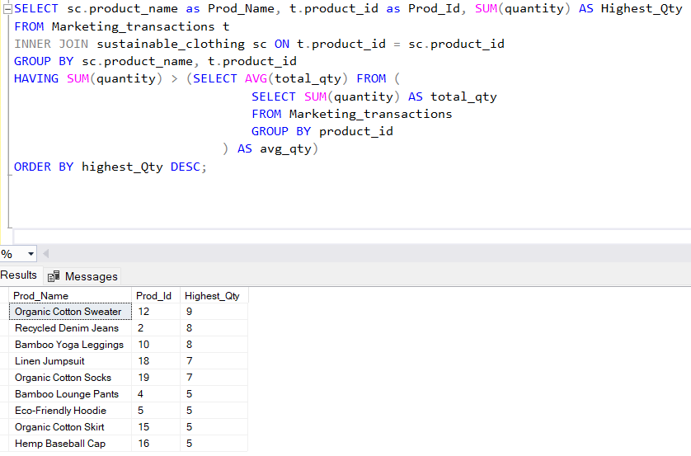
5. Which products had a higher quantity sold compared to the average quantity sold?

Slide 9
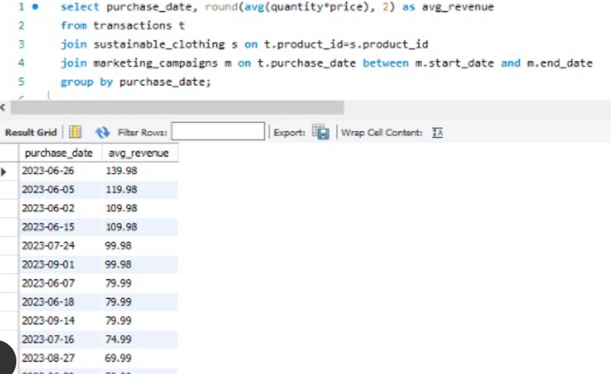
6. What is the average revenue generated per day during the marketing campaigns?

Slide 10
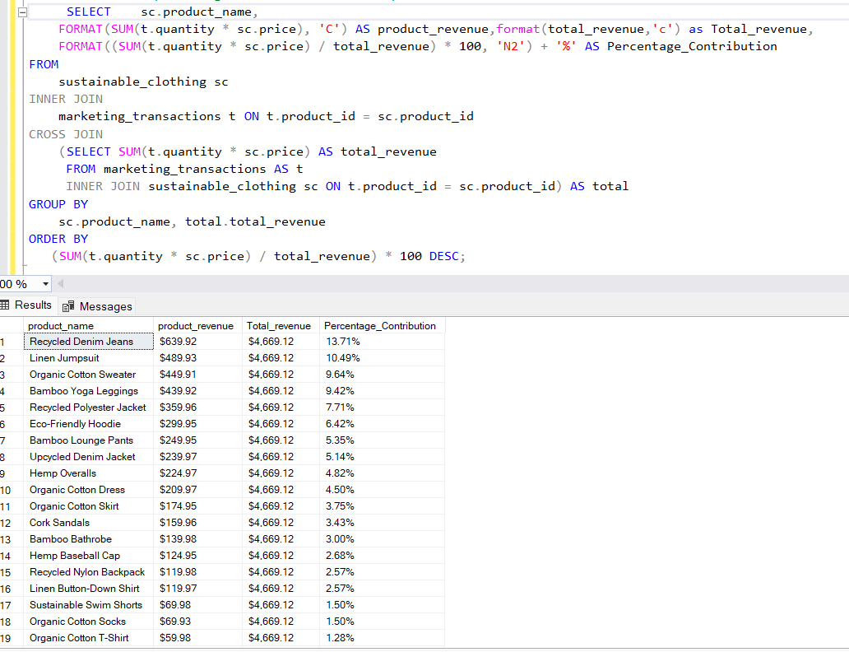
7. What is the percentage contribution of each product to the total revenue?

Slide 11
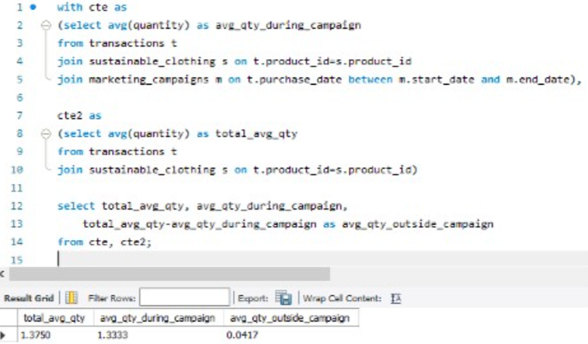
8. Compare the average quantity sold during marketing campaigns to outside the marketing campaigns

Slide 12
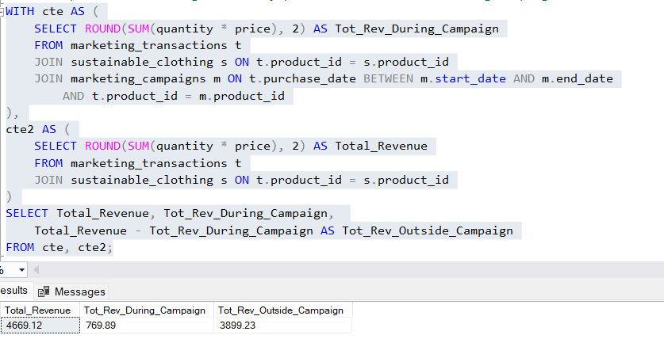
9. Compare the revenue generated by products inside the marketing campaigns to outside the campaigns

Slide 13
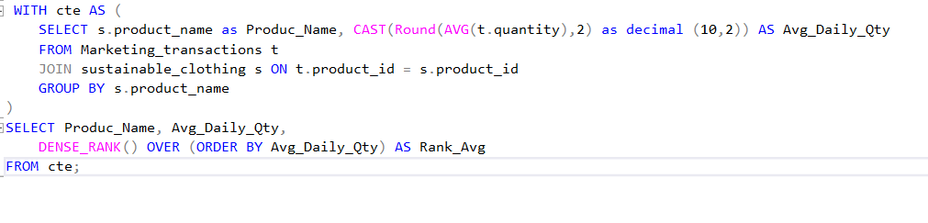
10. Rank the products by their average daily quantity sold

Slide 14
